Slide 1

DBMS MINI PROJECT
Dr. AMBEDKAR INSTITUTE OF TECHNOLOGY
Near Jnana Bharathi Campus, Bengaluru-560 056.
(An Autonomous Institution, Aided by Government of Karnataka)
Department of computer science & engineering 2023-24
Course Code : 21CLS505
Mini project on
“Streamlining Room Management and Rentals”
Bachelor of engineering in
Computer science and engineering

Slide 2
Streamlining Room Management and Rentals:
PROJECT MEMBERS:
1DA21CS092: NADDANA YASHWANTH
BACKEND:
Design Of Schema.
Listing Schema.
Review Schema.
User Schema .
With Schema and Entity Rational Diagrams.
1DA22CS409: HAJARATALI S MOGALLAI
FRONTEND:
BACKEND:
Index page
Show page
Commenting
Review
With Express js
Writing Routes
Writing Methods
With node js

Slide 3
Project Overview:
The project seems to be a property rental and listing platform where users can browse, create, and manage property listings. It includes features for creating, updating, and deleting property listings, managing reviews, categorizing listings by type, and implementing a search functionality. Additionally, there are modules for user authentication, menu management, and the creation of rental menus associated with specific listings.
Key Features and Functionalities:
Property Listings:
Users can view a list of all property listings on the homepage.
Detailed information about each listing, including images, is displayed on individual listing pages.
The project allows for the creation, editing, and deletion of property listings.
User Authentication:
Users can sign up for accounts, log in, and log out.
Authentication is integrated with Passport.js, providing secure user registration and login processes.
Menu Management:
There is a module for creating and managing menus associated with specific listings.
Menus include information about different items, and users can create, edit, and delete menu items.
Search Functionality:
The project includes a search feature allowing users to search for listings based on titles, categories, or locations.
Listing Categories:
Property listings are categorized based on types such as Cottage, Residential, Commercial, Vacation, Apartment, Condo, Townhouse, and Other.

Slide 4
Review System:
Users can leave reviews for specific property listings.
The reviews are associated with the respective listings and are displayed on the listing detail pages.
User Profile:
Users have profiles where they can manage their information and potentially view their rental history.
Trending Listings:
There is a module to display trending listings based on reviews with a rating of 5.
Search Functionality:
Users can perform searches for listings based on titles, categories, and locations.
Error Handling and Flash Messages:
The project includes error handling to manage potential issues during user interactions.
Flash messages are used to provide feedback to users after certain operations.
Additional Modules:
Menu Integration:
There is a separate set of modules related to menu creation and management, allowing users to add menus to specific listings.
User Authentication and Authorization:
Passport.js is used for user authentication, providing a secure and customizable authentication system.
Rental Module:
There is a module related to renting properties, allowing users to book and manage rental periods.

Slide 5
Considerations:
The project appears to be built using a Node.js framework, possibly Express.js, and is likely connected to a MongoDB database.
Middleware like connect-flash is used for displaying flash messages to users.
File uploads, possibly for listing images, are handled using middleware that works with file paths and filenames.

Slide 6
Streamlining Room Management and Rentals:
BACKEND: E-R Diagram.
comment
Author_id
Title
City
Menu_Id
Review_id
Created_at
listing_id
id (PK)
Image
Description
Rating
Price
N
Listing
1
Reviews
Revies for listing
N
Rents_Id
end_date
Location
N
M
Revies from users
listing_id
M
category
Can rent
List the property
1
1
start_date
The menu for listing
User
1
Rents_id
N
listing_id
1
user_id
N
User can rent
N
Orders
Username
Rents
N
Menu
food_items
user_id
Email
price
menu_id
item_type
user_id

Slide 7
BACKEND: Backend-Data
All Shema's in mongoose using MongoDB:
User Schema:
Review Schema:
const mongoose = require('mongoose');
const userSchema = new mongoose.Schema({
username: String,
email: String,
password: String
});
const User = mongoose.model('User', userSchema);
module.exports = User;
const mongoose = require('mongoose');
const reviewSchema = new mongoose.Schema({
property_id: mongoose.Schema.Types.ObjectId,
user_id: mongoose.Schema.Types.ObjectId,
rating: Number,
comment: String
});
const Review = mongoose.model('Review', reviewSchema);
module.exports = Review;

Slide 8
BACKEND: Backend-Data
All Shema's in mongoose using MongoDB:
listing Schema
Rent Schema
const mongoose = require('mongoose');
const propertySchema = new mongoose.Schema({
title: String,
description: String,
image: { url: String, filename: String },
price: Number,
location: String,
country: String,
category: String,
owner_id: mongoose.Schema.Types.ObjectId,
reviews: [{ type: mongoose.Schema.Types.ObjectId, ref: 'Review' }],
__v: Number
});
const Property = mongoose.model('Property', propertySchema);
module.exports = Property;
const mongoose = require('mongoose');
const rentSchema = new mongoose.Schema({
property_id: mongoose.Schema.Types.ObjectId,
start_date: Date,
end_date: Date
});
const Rent = mongoose.model('Rent', rentSchema);
module.exports = Rent;

Slide 9
BACKEND: Backend-Data
All Shema's in mongoose using MongoDB:
Menu Schema:
const mongoose = require('mongoose');
const menuSchema = new mongoose.Schema({
property_id: mongoose.Schema.Types.ObjectId,
dish_name: String
});
const Menu = mongoose.model('Menu', menuSchema);
module.exports = Menu;

Slide 10
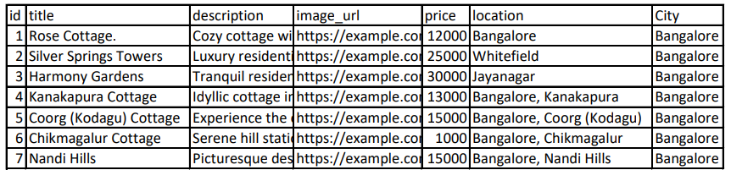
Quires and Back end Data:
BACKEND: Backend-Data
const listings = await listing.find({});

Slide 11
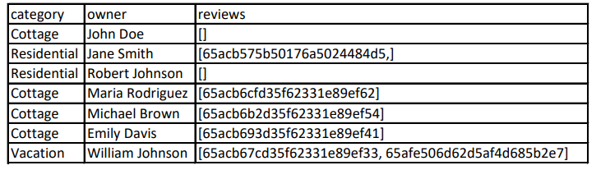
Quires and Back end Data:
BACKEND: Backend-Data
const listings = await listing.find({});

Slide 12
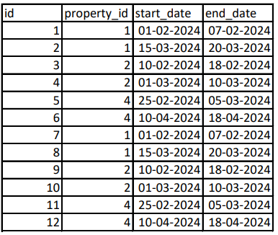
BACKEND: Backend-Data
Quires and Back end Data:
const rents = await Rent.find({});

Slide 13
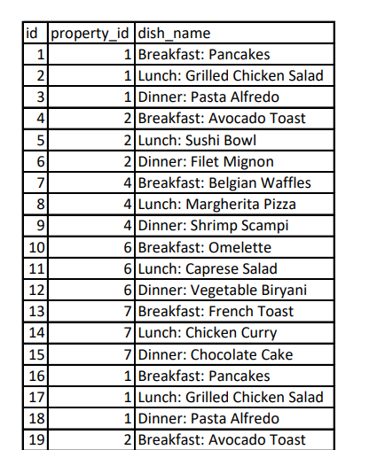
BACKEND: Backend-Data
Quires and Back end Data:
const menuItems = await Menu.find({});

Slide 14
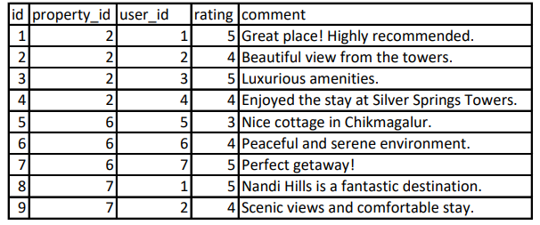
BACKEND: Backend-Data
Quires and Back end Data:
const reviews = await Review.find({});

Slide 15
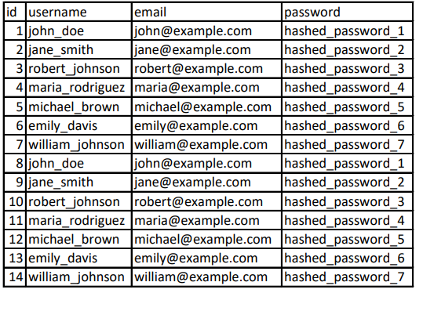
Quires and Back end Data:
BACKEND: Backend-Data
const users = await User. Find({});

Slide 16
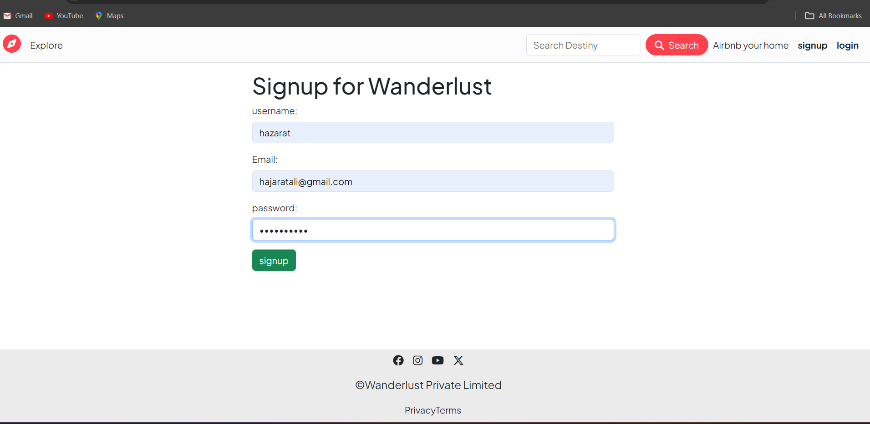
Signup page /from

Slide 17
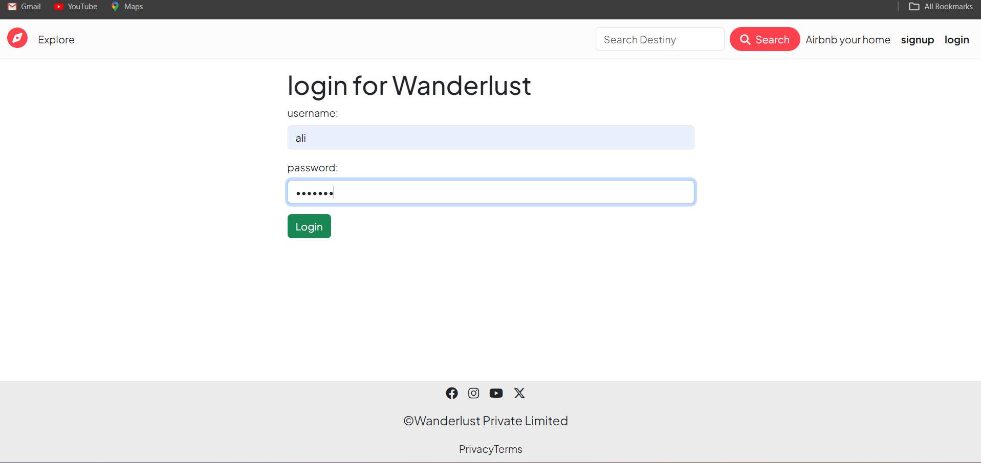
Login from

Slide 18
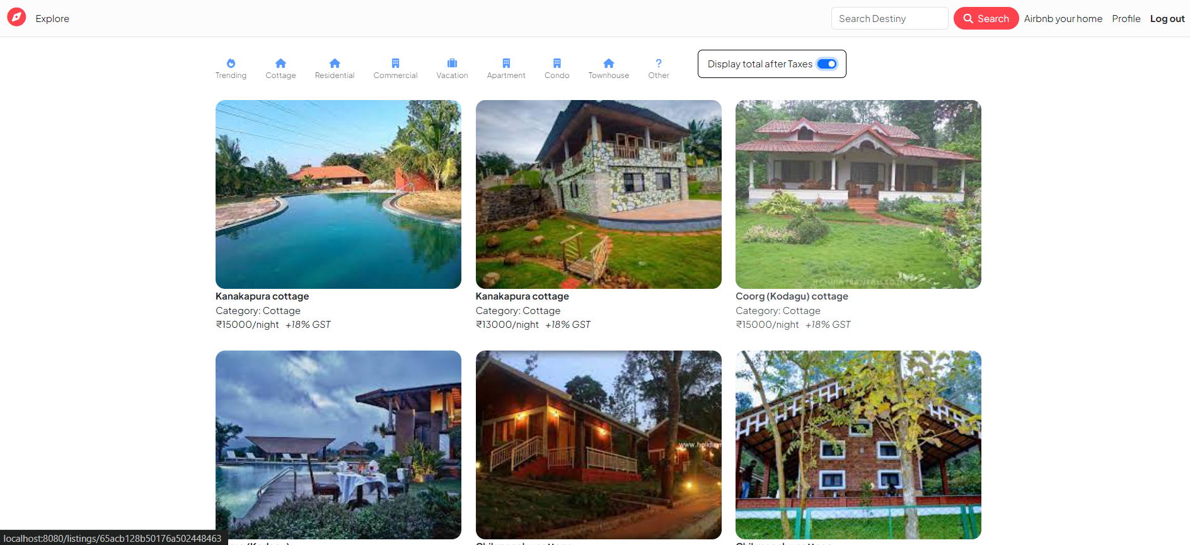
Front End:
The Front-End snapshots
Main page / Index page

Slide 19
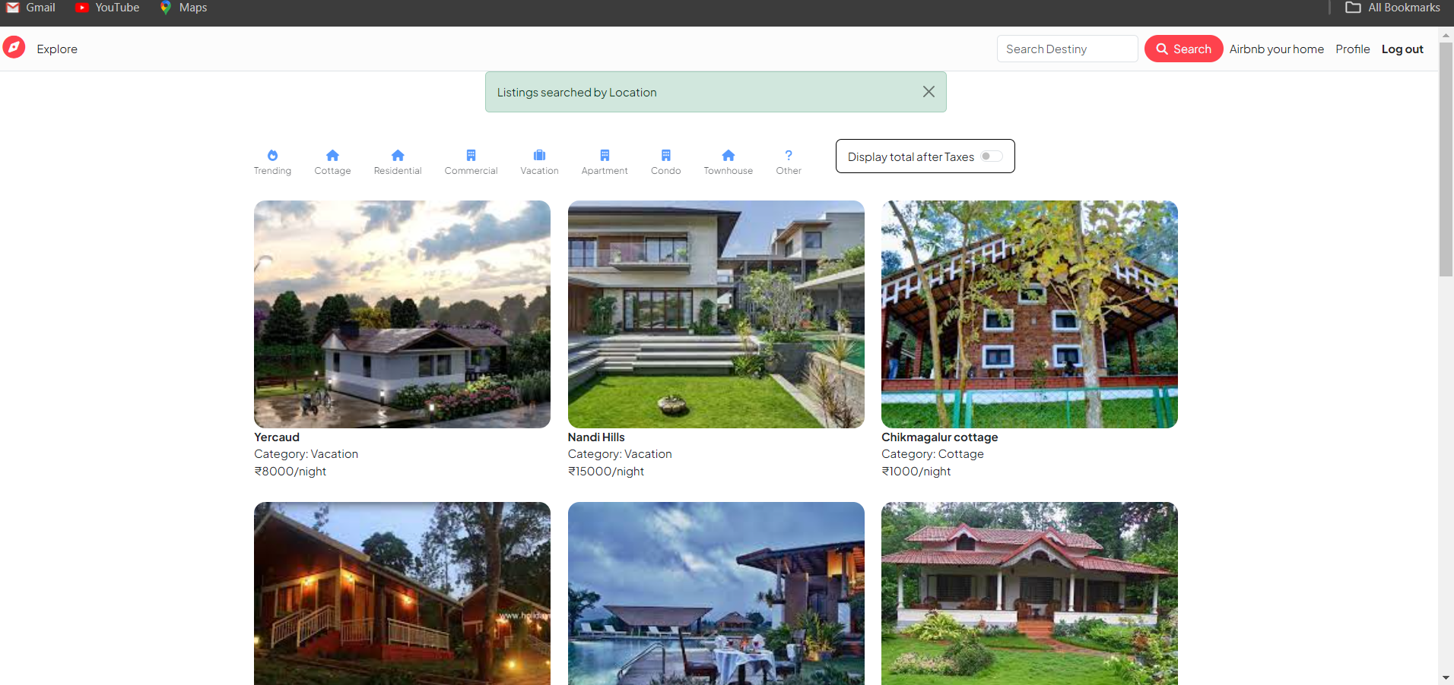
Main page / Index page

Slide 20
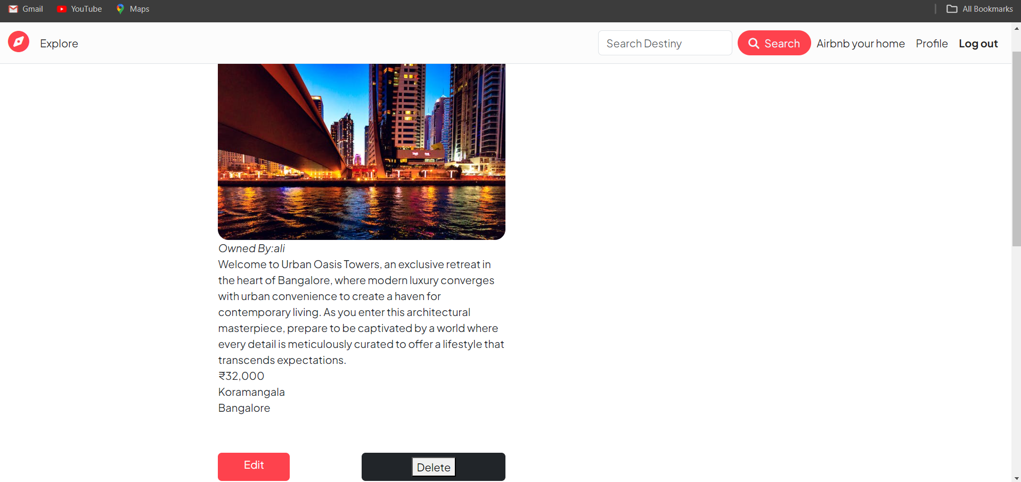
Show Page Details of listing

